Slide 1
DATA CURATION PROJECT
ON
COVID-19 cases, tests and deaths by ZIP code
Amrutham Lakshmi Himaja
Atharva Kadam
Saikrishna Rachha
Shivcharan Bharathi

Slide 2
DELIVERABLES
Data Gathering
Data Extraction and Analysis
Improving Data Quality
Problems in Dataset along with observations
Possible solutions to Data cleaning and Quality problems

Slide 3
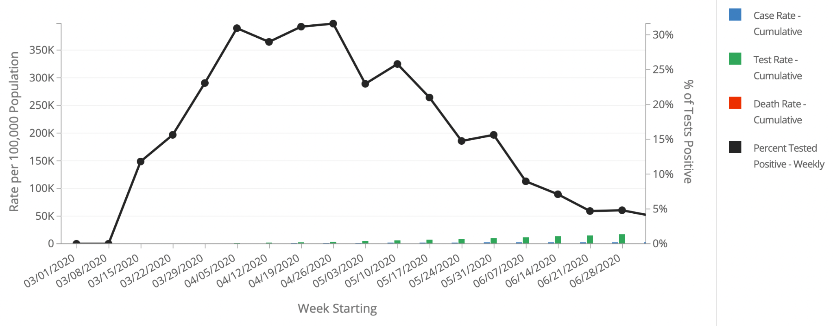
DATA GATHERING
The dataset we are using is COVID-19 Cases Tests and Deaths by ZIP Code which is gathered from the source – City of Chicago Data Portal
The dataset has 6541 rows and 21 columns.
The datas in the dataset are updated weekly

Slide 4
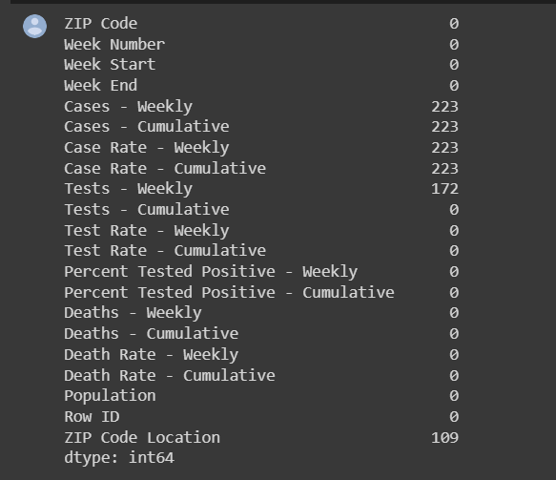
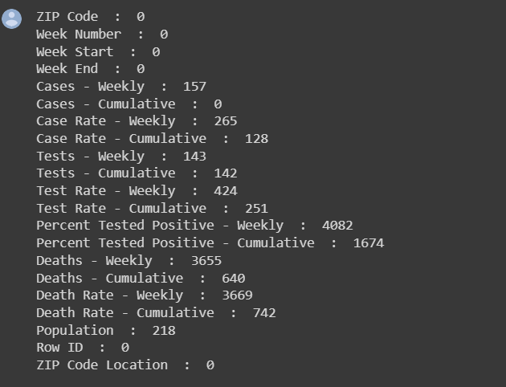
DATA ANALYSIS
The value of population in certain rows are zero.
There are a lot of Null values (blank spaces)in multiple columns.
There are 0’s in certain columns which logically is incorrect.
The percentage values were incorrect since it ranged from 0.1-0.5.
Fig. 1 - Total number of NaN values
Fig. 2 - Total number of 0 values

Slide 5
IMPROVING DATA QUALITY
There are a couple of methods which we have implemented or rather proposed to fix the above given problems.
For each column a formula is introduced in such a way that it can help determine the 0, null or incorrect values.
A specific set of steps is given are implemented for curating the project and they are listed below.

Slide 6
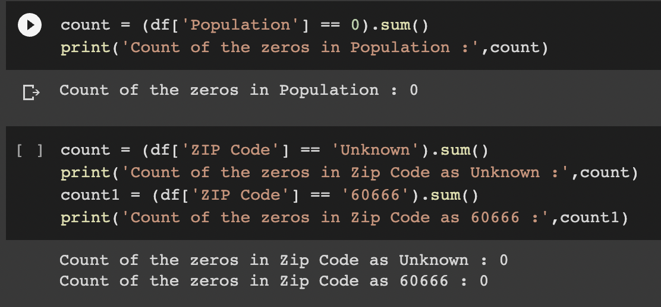

STEP - 1
We have selected the dataset which does not contain zero’s in the population column – because of the Divide by 0 Exception
The one dependency we found with the population column is ZIP code with 60666 and Unknown have the population as 0.
Second dependency is Cases Rate Weekly and Cases Rate Cummulative

Slide 7
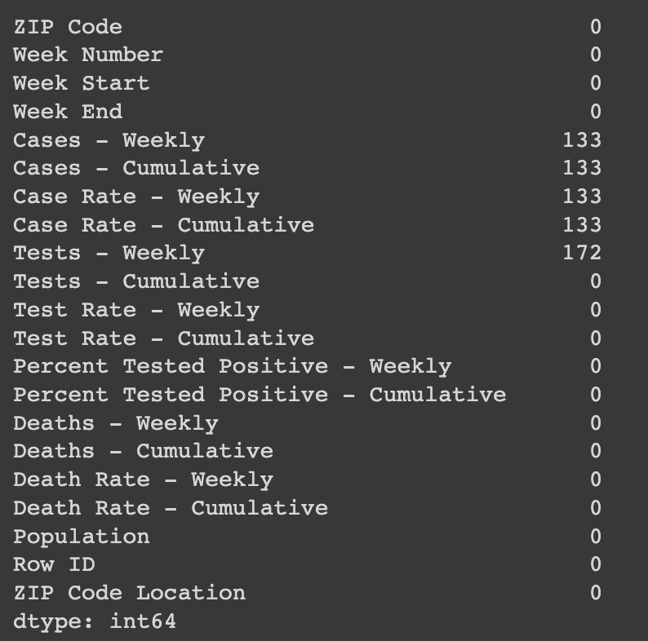
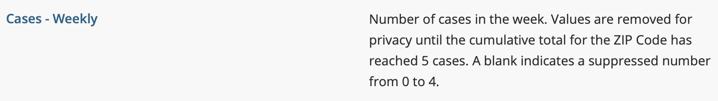
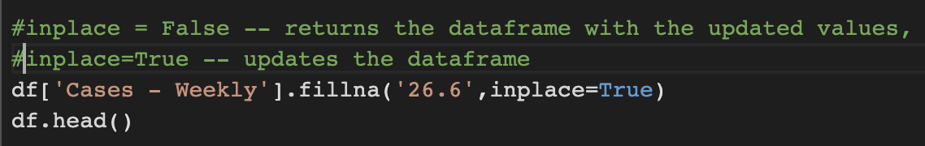
STEP - 2
The other dependency we observed in the other dataset is Cases weekly and Cases cumulative – both are dependent on each other.
The NaN values in both the Cases Cumulative and the Cases weekly are replaced with a value 26.6.
Formula - (Number of NaN values)/5.

Slide 8
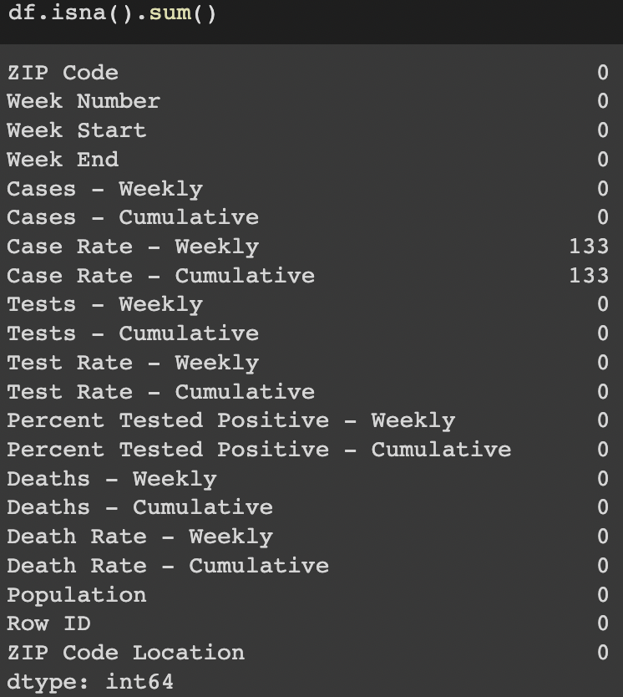
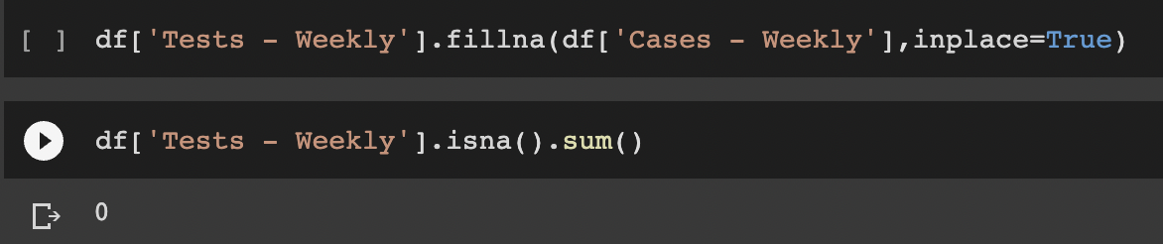
STEP - 3
We found zero values in the Test Weekly column which is not directly dependent on Cases Weekly but indirectly it is.
We have replaced the 0 values of the Test Weekly with the Cases Weekly because it was the bare minimum number of tests which were done per week.

Slide 9
STEP - 4
As we discussed before the dependency of Population column on Cases Rate Weekly and Cases Rate Cummulative.The case rate weekly had a lot of values which were NULL or BLANK and they were fixed by the formula.
Case Rate Weekly = (Cases Weekly * 100,000)/Population
Case Rate Cumulative = (Cases Cumulative * 100,000)/Population

Slide 10
STEP - 5
The percent positive weekly was a value which was rounded up in the table and ranged from 0.0-0.5.
The formula to calculate this was determined and then the value was multiplied by 100 to get a more accurate value.
Formula - (Cases Weekly/Tests Weekly) * 100

Slide 11
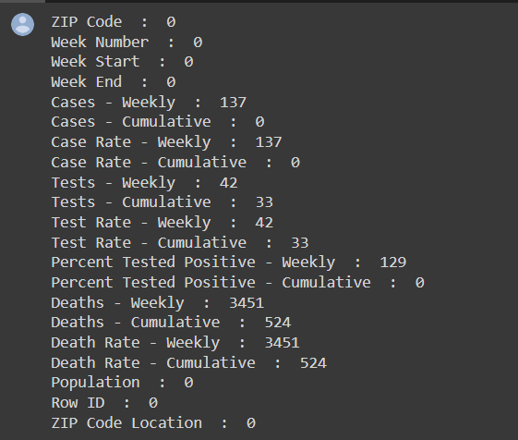
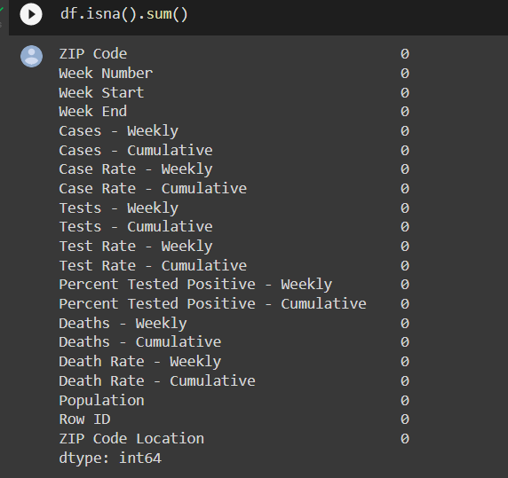
DATA CURATION RESULTS

Slide 12
CONCLUSION
The importance of any data relies in its quality since it has to be cleaned and rectified periodically and curation was very important for understanding the data.
Each column had a formula derivation which was implemented and solved according to it.

